Slide 1
Capstone Project Battle of Neighborhoods
Where is the proper location in New York to open a restaurant?

Slide 2

Introduction
Using Data science analytics, location data and map of the area we help business to solve their problem to find a better place to open a new restaurant which turns out to be profitable to the clients.
To answer this question we need data and information about the food chains and restaurants in the city of New York.
For this data we collect it from the freely available datasets from the internet.

Slide 3
Collection
Data We collected the data from NYU spatial data repository. Foursquare location and venue data. We collected the names of the neighborhoods and communities present in the city with the help of the NYU spatial data repository. We collected the names of restaurants and venues all around the city of New York with the help of the Foursquare location data.

Slide 4
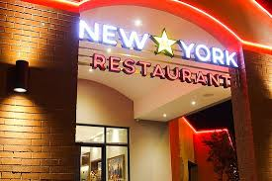

With all the needed data collected we can proceed to the analysis part of the problem where find the best possible solution to the problem

Slide 5
Results
Observing the 5 clusters we can say that the clusters 1, 3 and 4 are not the clusters we are searching for. There is no apparent benefit if any restaurant business is started in the areas which fall under the clusters 1, 3 and 4.
Examining the clusters 2 and 5 we can easily say that this is the best place to open a restaurant.

Slide 6
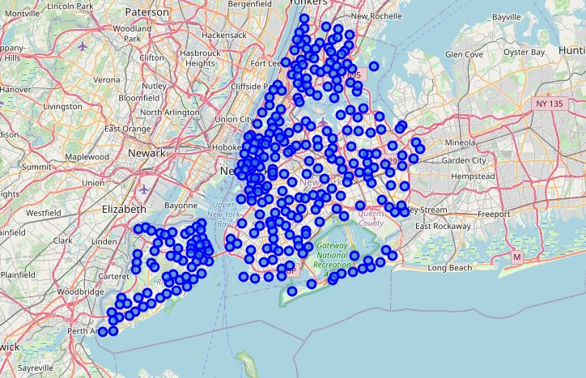
Cluster map of New York

Slide 7

Conclusion
On concluding we can say that the cluster 2 is the best option to open a restaurant business. Cluster 5 also satisfies the needs but the heavy competition, less public transport facilities make it less chosen option.
The final decision is taken by the client based on their resources and choices.

